Slide 1
Chapter 9: Multiarea OSPF
Instructor Materials
CCNA Routing and Switching
Scaling Networks v6.0
Notes:
Cisco Networking Academy Program
Scaling Networks v6.0
Chapter 9: Multiarea OSPF

Slide 2
Chapter 9: Multiarea OSPF
CCNA Routing and Switching
Scaling Networks v6.0
Notes:
Cisco Networking Academy Program
Scaling Networks v6.0
Chapter 9: Multiarea OSPF

Slide 3
Chapter 9 - Sections & Objectives
9.1 Multiarea OSPF Operation
Explain how multiarea OSPF operates in a small to medium-sized business network.
Explain why multiarea OSPF is used.
Explain how multiarea OSPFv2 uses link-state advertisements.
Explain how multiarea OSPF establishes neighbor adjacencies.
9.2 Implement Multiarea OSPF
Implement multiarea OSPFv2 and OSPFv3.
Configure multiarea OSPFv2 and OSPFv3 in a routed network.
Verify multiarea OSPFv2 and OSPFv3 operation.
Notes:
3
Cisco Networking Academy Program
Scaling Networks v6.0
Chapter 9: Multiarea OSPF

Slide 4
9.1 Multiarea OSPF Operation
Notes:
9 – Multiarea OSPF
9.1 – Multiarea OSPF Operation

Slide 5
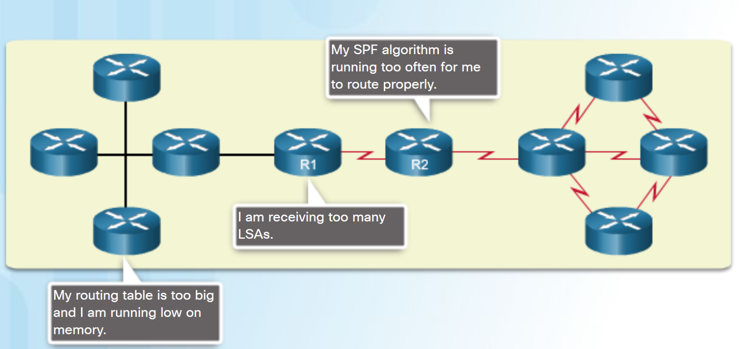
Why Multiarea OSPF? Single-Area OSPF
Issues in a large single area OSPF:
Large routing table
Large link-state database (LSDB)
Frequent SPF algorithm calculations
To make OSPF more efficient and scalable, OSPF supports hierarchical routing using areas.
Notes:
9.1 – Multiarea OSPF Operation
9.1.1 – Why Multiarea OSPF?
9.1.1.1 – Single-Area OSPF

Slide 6
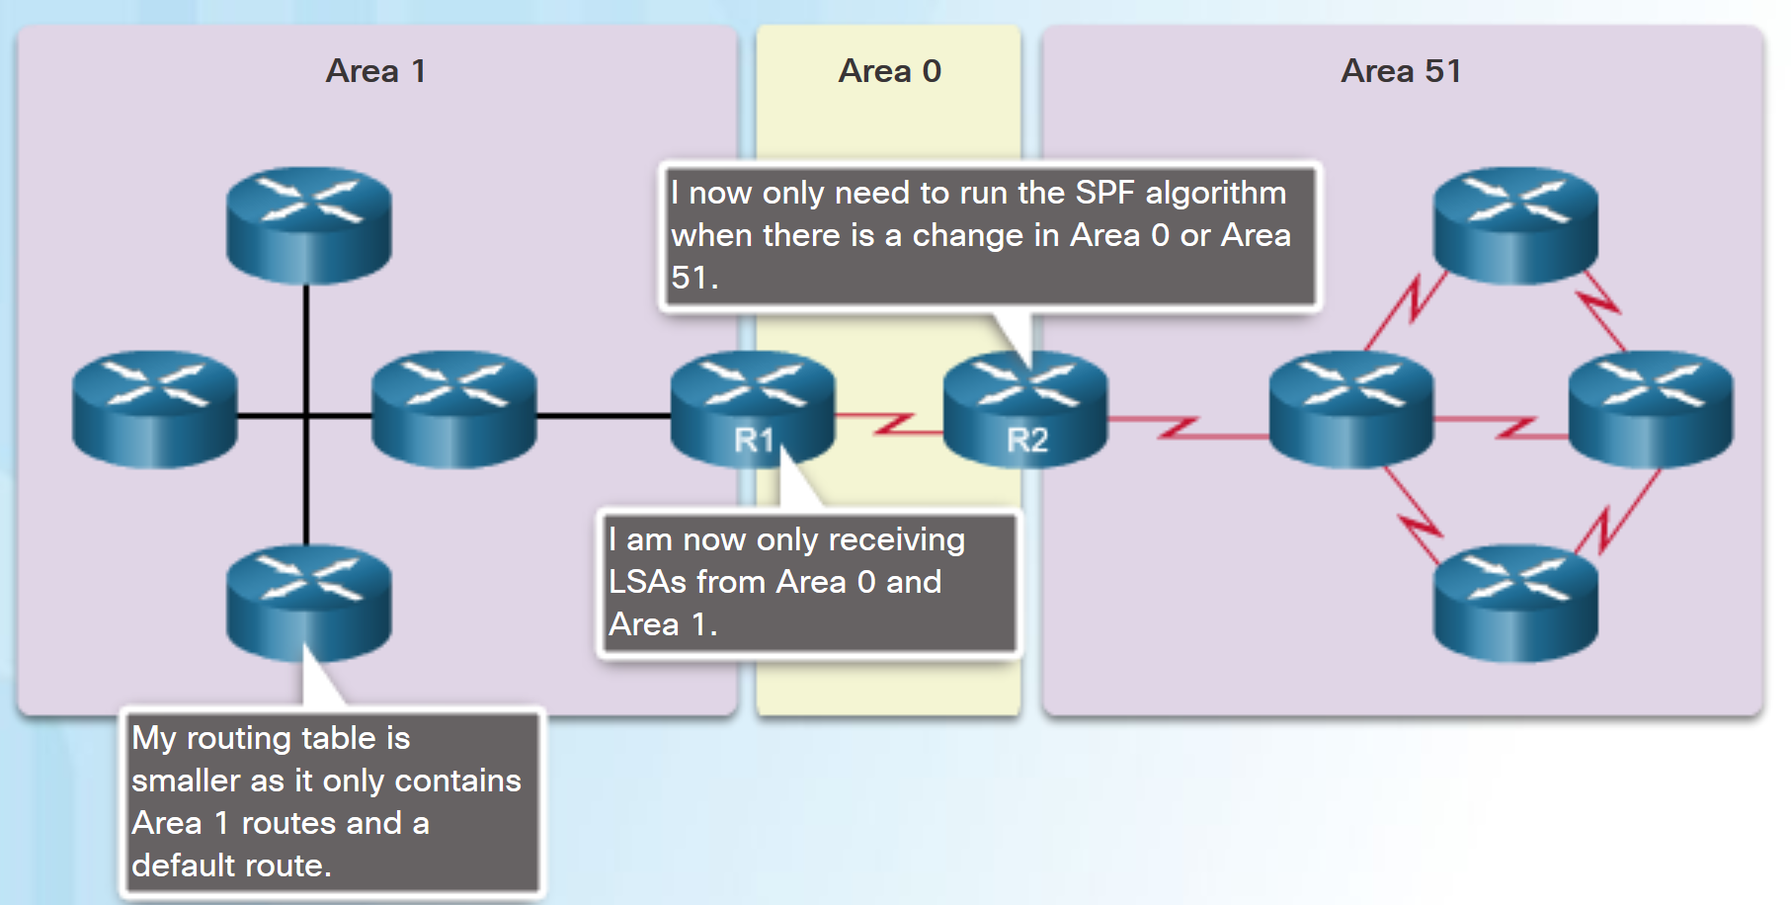
Why Multiarea OSPF? Multiarea OSPF
Multiarea OSPF:
Large OSPF area is divided into smaller areas.
Reduces processing and memory overhead.
Requires a hierarchical network design.
The main area is the backbone area (area 0) and all other areas connect to it.
Advantages of Multiarea OSPF:
Smaller routing tables - Fewer routing table entries as network addresses can be summarized between areas.
Reduced link-state update overhead.
Reduced frequency of SPF calculations.
Notes:
9.1 – Multiarea OSPF Operation
9.1.1 – Why Multiarea OSPF?
9.1.1.2 – Multiarea OSPF

Slide 7
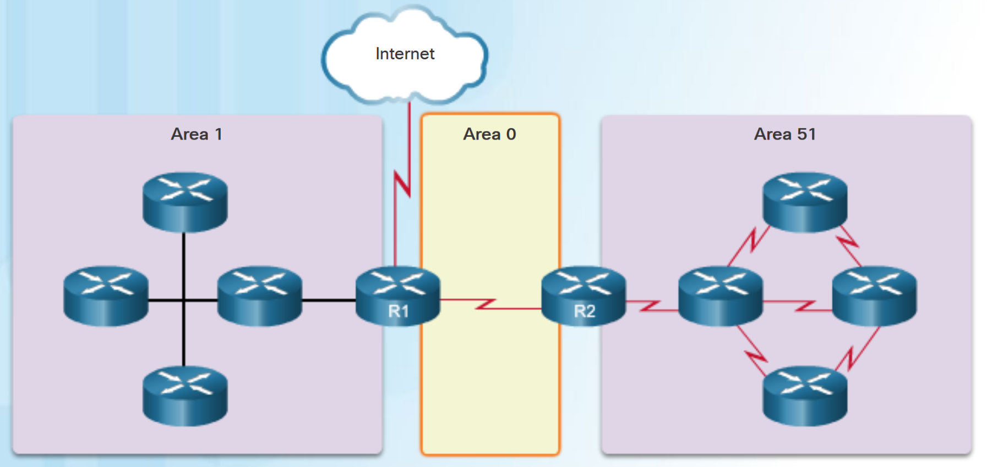
Why Multiarea OSPF? OSPF Two-Layer Area Hierarchy
Multiarea OSPF is implemented in a two-layer area hierarchy.
Backbone (Transit) area - An OSPF area whose primary function is the fast and efficient movement of IP packets:
Interconnects with other OSPF area types.
Also called OSPF area 0.
Regular (nonbackbone) area - Connects users and resources:
Usually set up along functional or geographical groupings
All traffic from other areas must cross a transit area.
Notes:
9.1 – Multiarea OSPF Operation
9.1.1 – Why Multiarea OSPF?
9.1.1.3 – OSPF Two-Layer Area Hierarchy

Slide 8
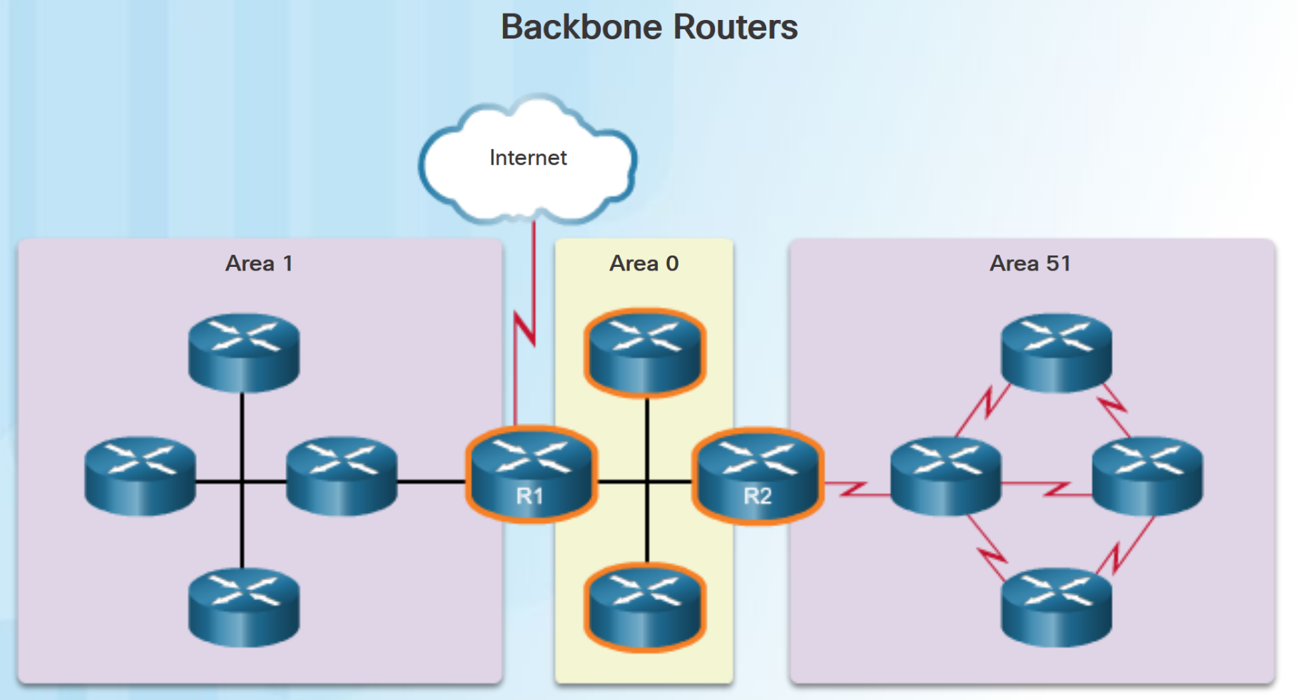
Why Multiarea OSPF? Types of OSPF Routers
There are four different types of OSPF routers:
Internal router –A router that has all of its interfaces in the same area.
Backbone router - A router in the backbone area. The backbone area is set to area 0
Area Border Router (ABR) – A router that has interfaces attached to multiple areas.
Autonomous System Boundary Router (ASBR) – A router that has at least one interface attached to an external internetwork.
A router can be classified as more than one router type.
Notes:
9.1 – Multiarea OSPF Operation
9.1.1 – Why Multiarea OSPF?
9.1.1.4 – Types of OSPF Routers

Slide 9
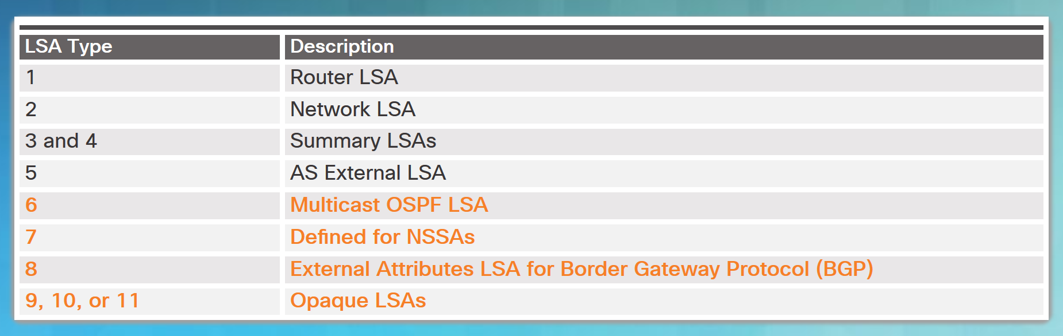
Multiarea OSPF LSA Operation OSPF LSA Types
LSAs individually act as database records and provide specific OSPF network details.
LSAs in combination describe the entire topology of an OSPF network or area.
Any implementation of multiarea OSPF must support the first five LSAs
Notes:
9.1 – Multiarea OSPF Operation
9.1.2 – Multiarea OSPF LSA Operation
9.1.2.1 – OSPF LSA Types

Slide 10
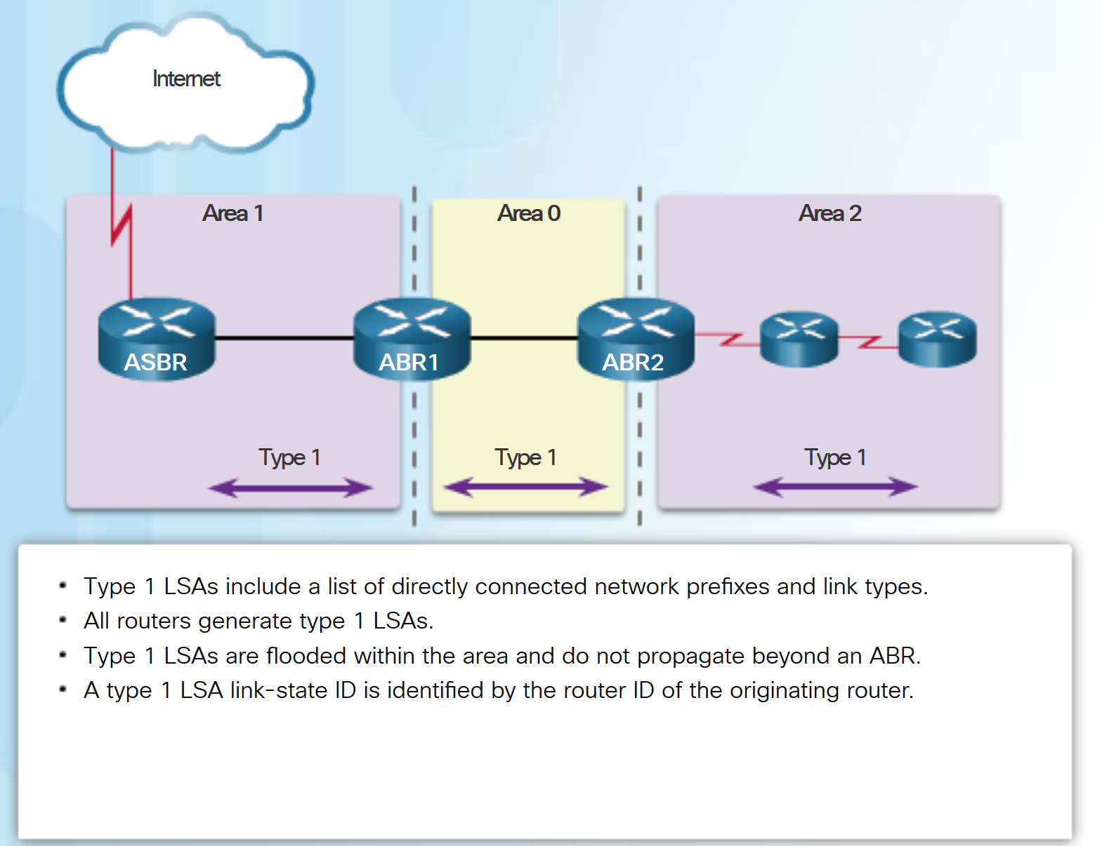
Multiarea OSPF LSA Operation OSPF LSA Type 1
Routers advertise their directly connected OSPF-enabled links in a type 1 LSA .
Type 1 LSAs are also referred to as router link entries.
Type 1 LSAs are flooded only within the area in which they originated.
ABRs advertise the networks learned from the type 1 LSAs to other areas as type 3 LSAs.
The type 1 LSA link ID is identified by the router ID of the originating router.
Notes:
9.1 – Multiarea OSPF Operation
9.1.2 – Multiarea OSPF LSA Operation
9.1.2.2 – OSPF LSA Type 1

Slide 11
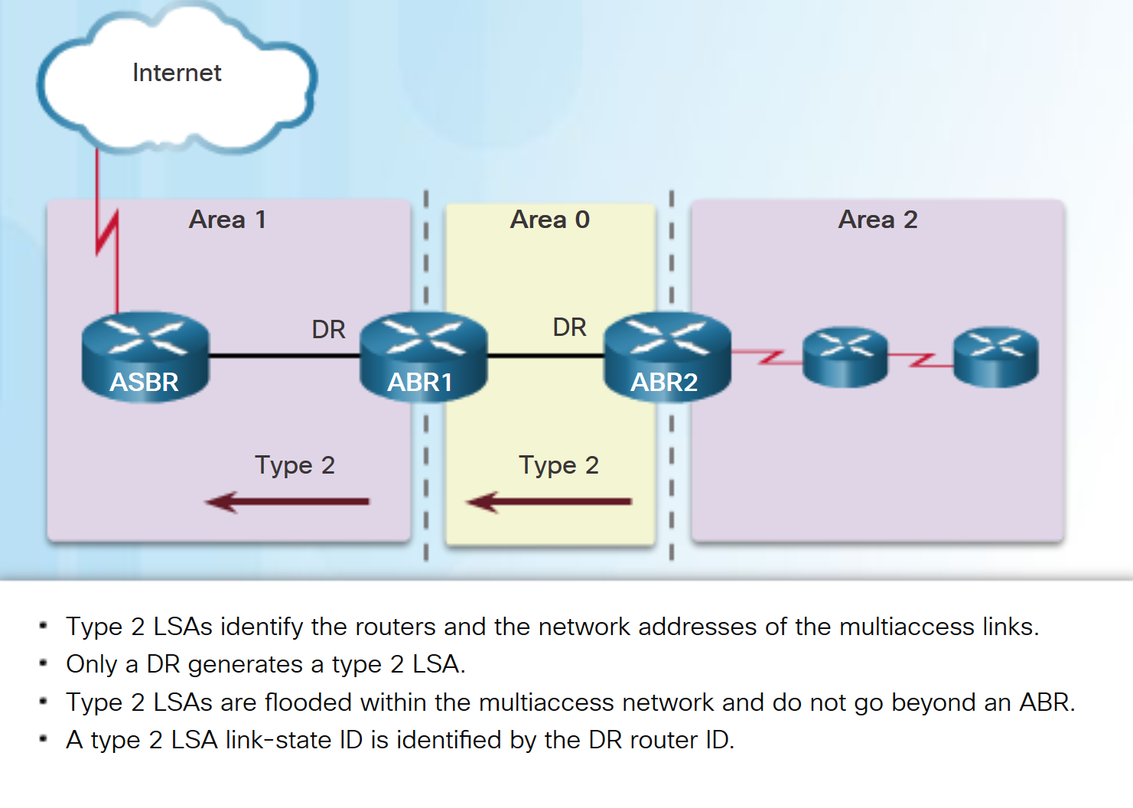
Multiarea OSPF LSA Operation OSPF LSA Type 2
Type 2 LSAs have the following characteristics:
Only found on multiaccess and nonbroadcast multiaccess (NBMA) networks
Contain the router ID and IP address of the DR, along with the router ID of all other routers on the multiaccess segment
Give other routers information about multiaccess networks within the same area
Not forwarded outside of an area
Also referred to as network link entries
Link-state ID is DR router ID
Notes:
9.1 – Multiarea OSPF Operation
9.1.2 – Multiarea OSPF LSA Operation
9.1.2.3 – OSPF LSA Type 2

Slide 12
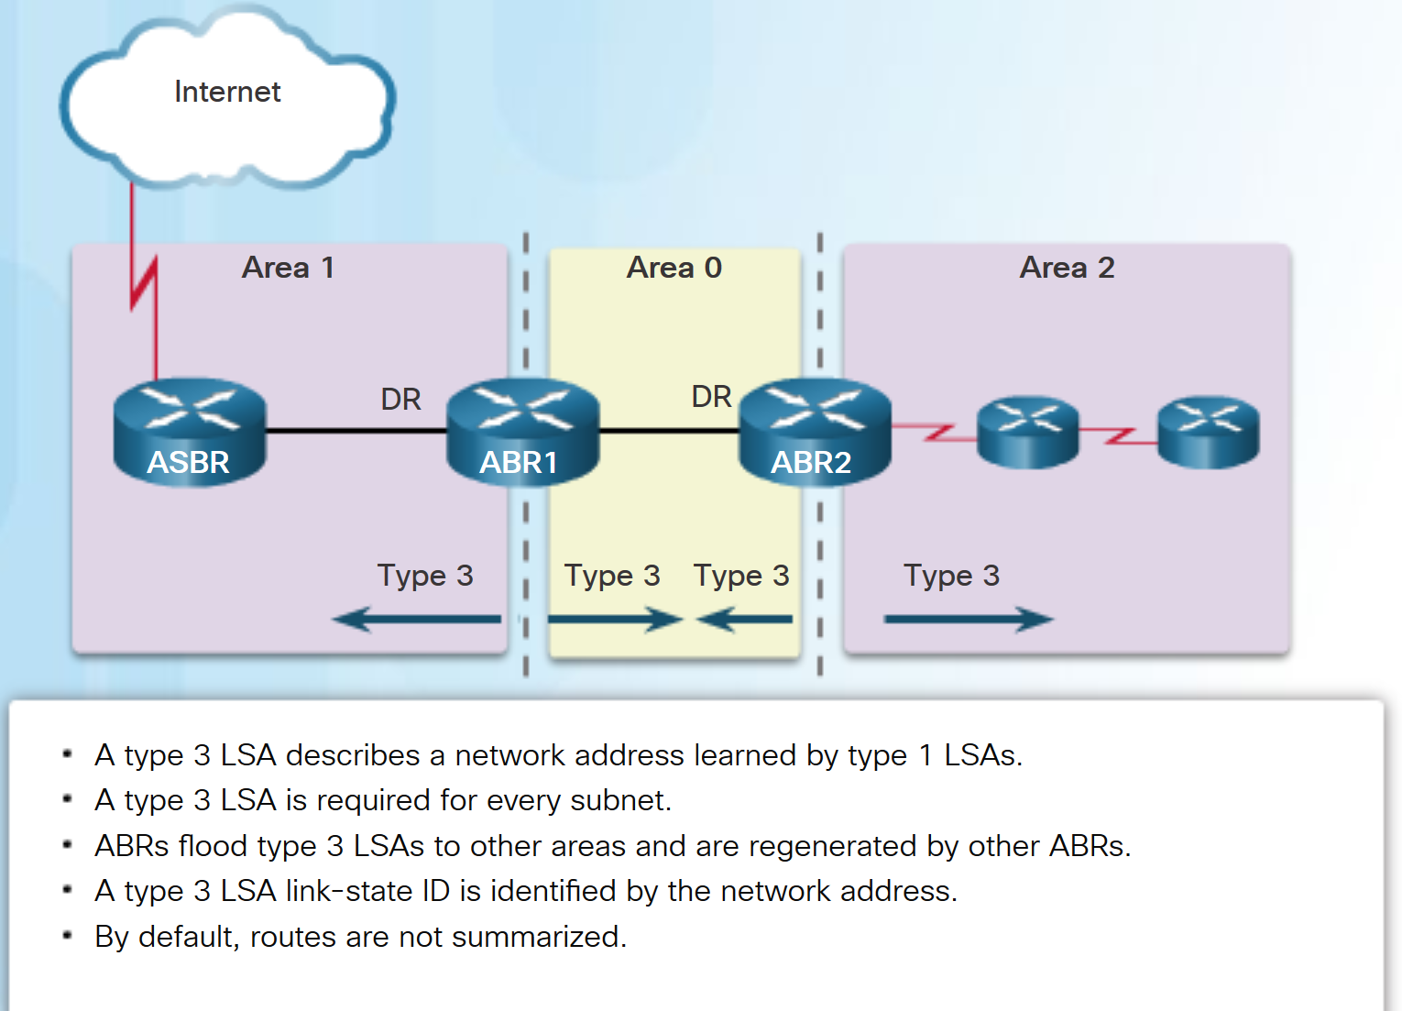
Multiarea OSPF LSA Operation OSPF LSA Type 3
Type 3 LSAs have the following characteristics:
They are used by ABRs to advertise networks from other areas.
The ABR creates a type 3 LSA for each of its learned OSPF networks.
ABRs flood type 3 LSAs from one area to other areas.
To reduce impact of flooding in a large OSPF deployment, configuration of manual route summarization on the ABR is recommended.
The link-state ID is set to the network address.
Notes:
9.1 – Multiarea OSPF Operation
9.1.2 – Multiarea OSPF LSA Operation
9.1.2.4 – OSPF LSA Type 3

Slide 13
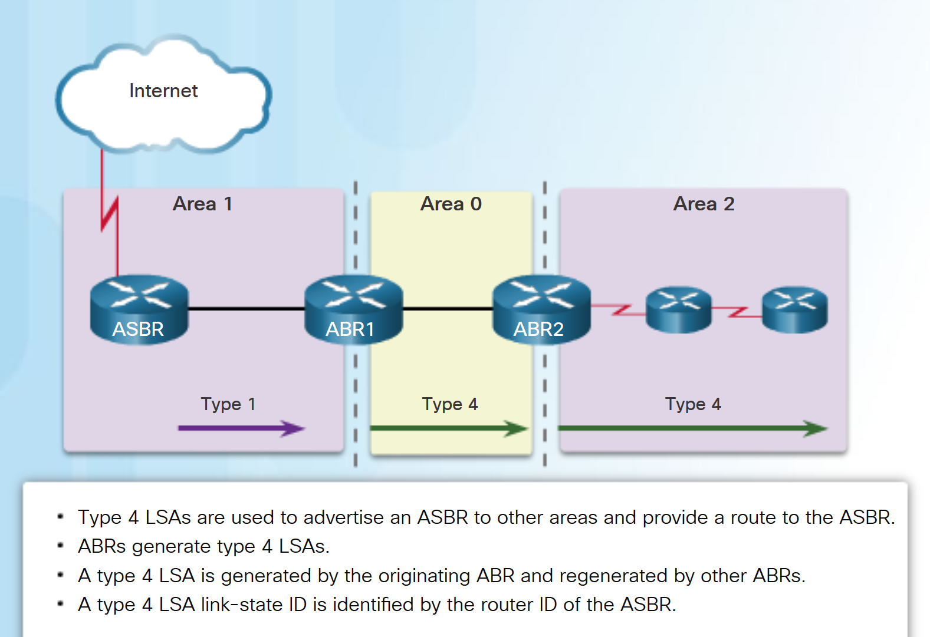
Multiarea OSPF LSA Operation OSPF LSA Type 4
Type 4 LSAs have the following characteristics:
They identify an ASBR and provide a route to it.
They are generated by an ABR only when an ASBR exists within an area.
They are flooded to other areas by ABRs.
The link-state ID is set to the ASBR router ID.
Notes:
9.1 – Multiarea OSPF Operation
9.1.2 – Multiarea OSPF LSA Operation
9.1.2.5 – OSPF LSA Type 4

Slide 14
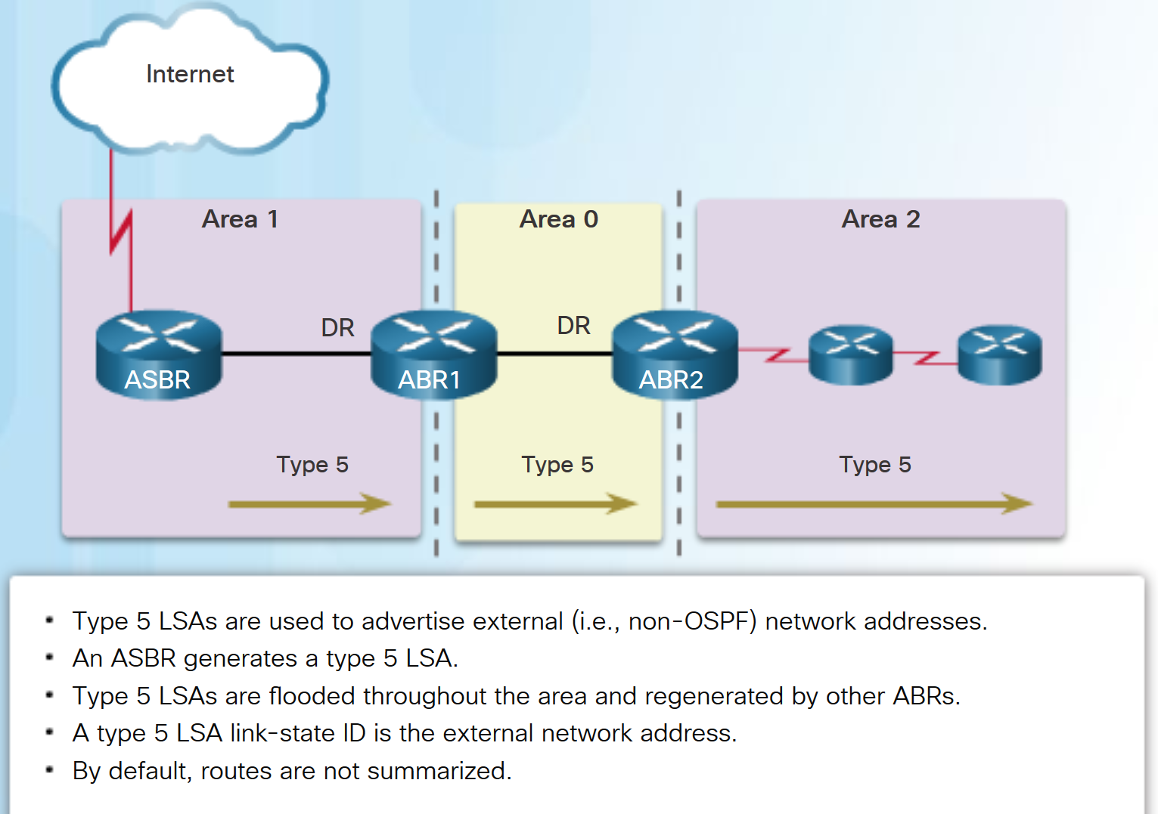
Multiarea OSPF LSA Operation OSPF LSA Type 5
Type 5 LSAs have the following characteristics:
They advertise external routes, also referred to as external LSA entries.
They are originated by the ASBR and flooded to the entire routing domain.
The link-state ID is the external network number.
Notes:
9.1 – Multiarea OSPF Operation
9.1.2 – Multiarea OSPF LSA Operation
9.1.2.6 – OSPF LSA Type 5

Slide 15
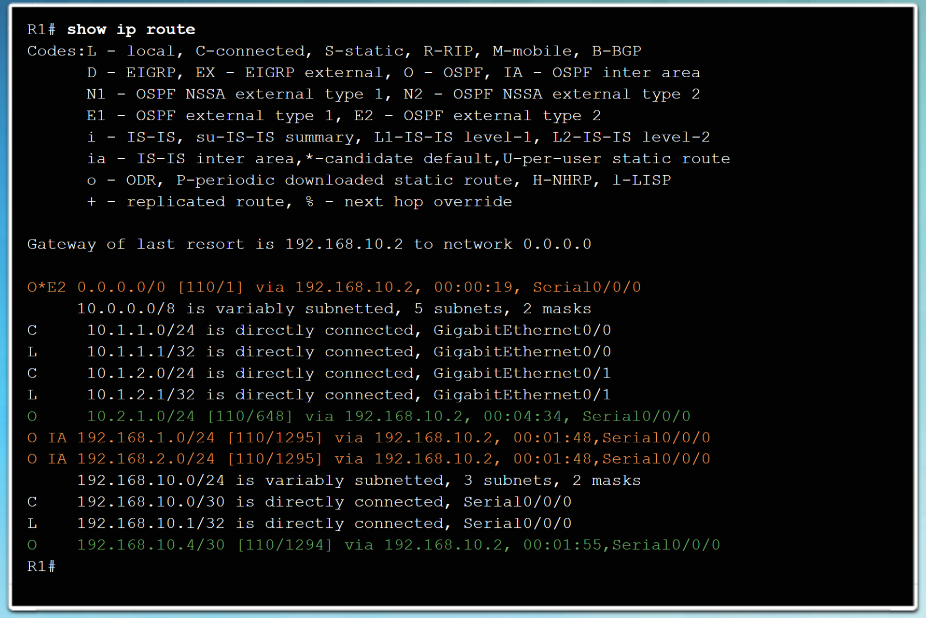
OSPF Routing Table and Types of Routes OSPF Routing Table Entries
OSPF routes in an IPv4 routing table are identified using the following descriptors:
O - The routing table reflects the link-state information with a designation of O, meaning that the route is intra-area
O IA - Summary LSAs appear in the routing table as IA (interarea routes).
O E1 or O E2 - External LSAs appear in the routing table marked as external type 1 (E1) or external type 2 (E2) routes.
Notes:
9.1 – Multiarea OSPF Operation
9.1.3 –OSPF Routing Table and Types of Routes
9.1.3.1 – OSPF Routing Table Entries

Slide 16
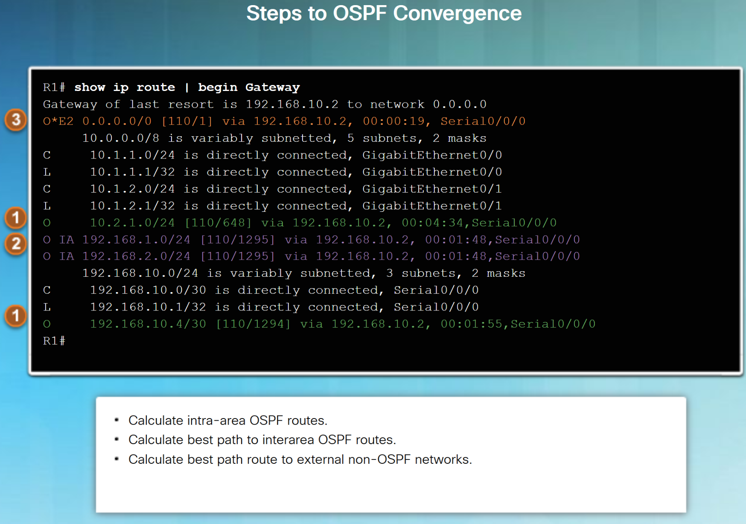
OSPF Routing Table and Types of Routes OSPF Route Calculation
The order in which the best paths are calculated is as follows:
All routers calculate the best path or paths to destinations within their area (intra-area). These are the type 1 and type 2 LSAs – O.
All routers calculate the best path or paths to the other areas within the internetwork. Type 3 LSAs - O IA.
All routers calculate the best path or paths to the external autonomous system (type 5) destinations - O E1 or an O E2 .
Notes:
9.1 – Multiarea OSPF Operation
9.1.3 –OSPF Routing Table and Types of Routes
9.1.3.2 – OSPF Route Calculation

Slide 17
9.2 Configuring Multiarea OSPF
Notes:
9 – Multiarea OSPF
9.2 – Configuring Multiarea OSPF

Slide 18
Configuring Multiarea OSPF Implementing Multiarea OSPF
There are 4 steps to implementing multiarea OSPF:
Step 1. Gather the network requirements and parameters
Step 2. Define the OSPF parameters
Single area or multiarea OSPF?
IP addressing plan
OSPF areas
Network topology
Step 3. Configure the multiarea OSPF implementation based on the parameters.
Step 4. Verify the multiarea OSPF implementation
Notes:
9.2 – Configuring Multiarea OSPF
9.2.1 – Configuring Multiarea OSPF
9.2.1.1 – Implementing Multiarea OSPF

Slide 19
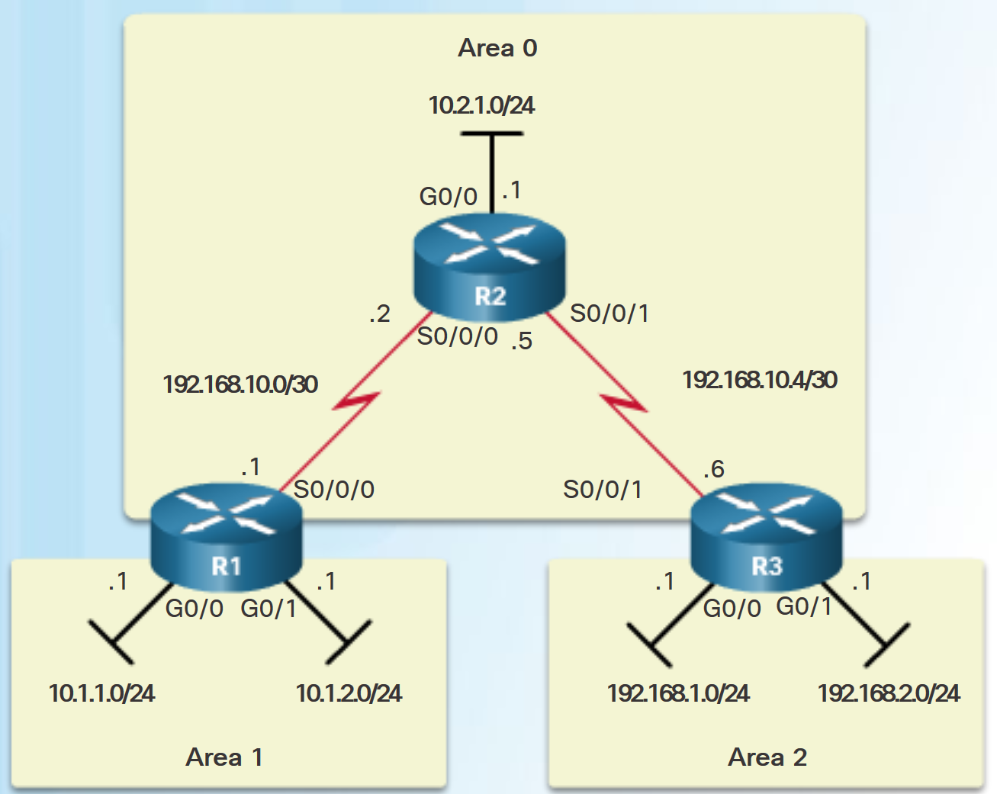
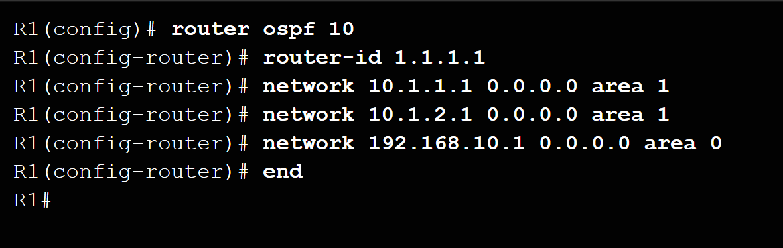
Configuring Multiarea OSPF Configuring Multiarea OSPFv2
There are no special commands to implement multiarea OSPFv2.
A router becomes an ABR when it has two network statements in different areas.
R1 is an ABR because it has interfaces in area 1 and an interface in area 0.
Notes:
9.2 – Configuring Multiarea OSPF
9.2.1 – Configuring Multiarea OSPF
9.2.1.2 – Configuring Multiarea OSPFv2

Slide 20
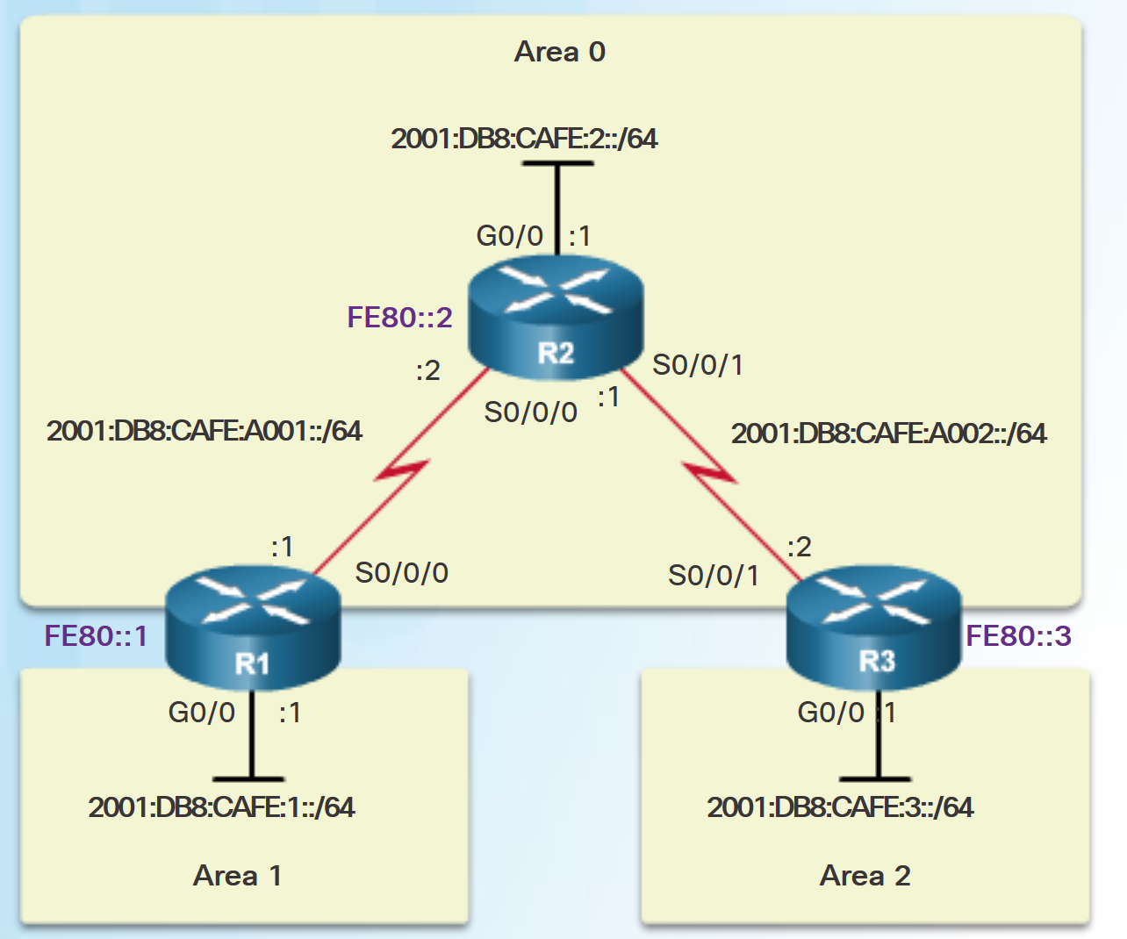
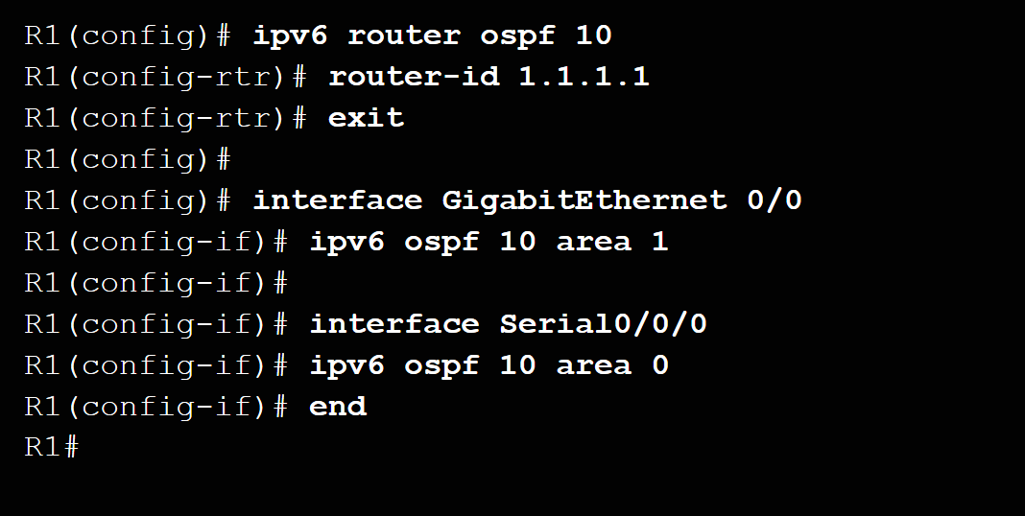
Configuring Multiarea OSPF Configuring Multiarea OSPFv3
There are no special commands required to implement multiarea OSPFv3.
A router becomes an ABR when it has two interfaces in different areas.
Notes:
9.2 – Configuring Multiarea OSPF
9.2.1 – Configuring Multiarea OSPF
9.2.1.3 – Configuring Multiarea OSPFv3

Slide 21
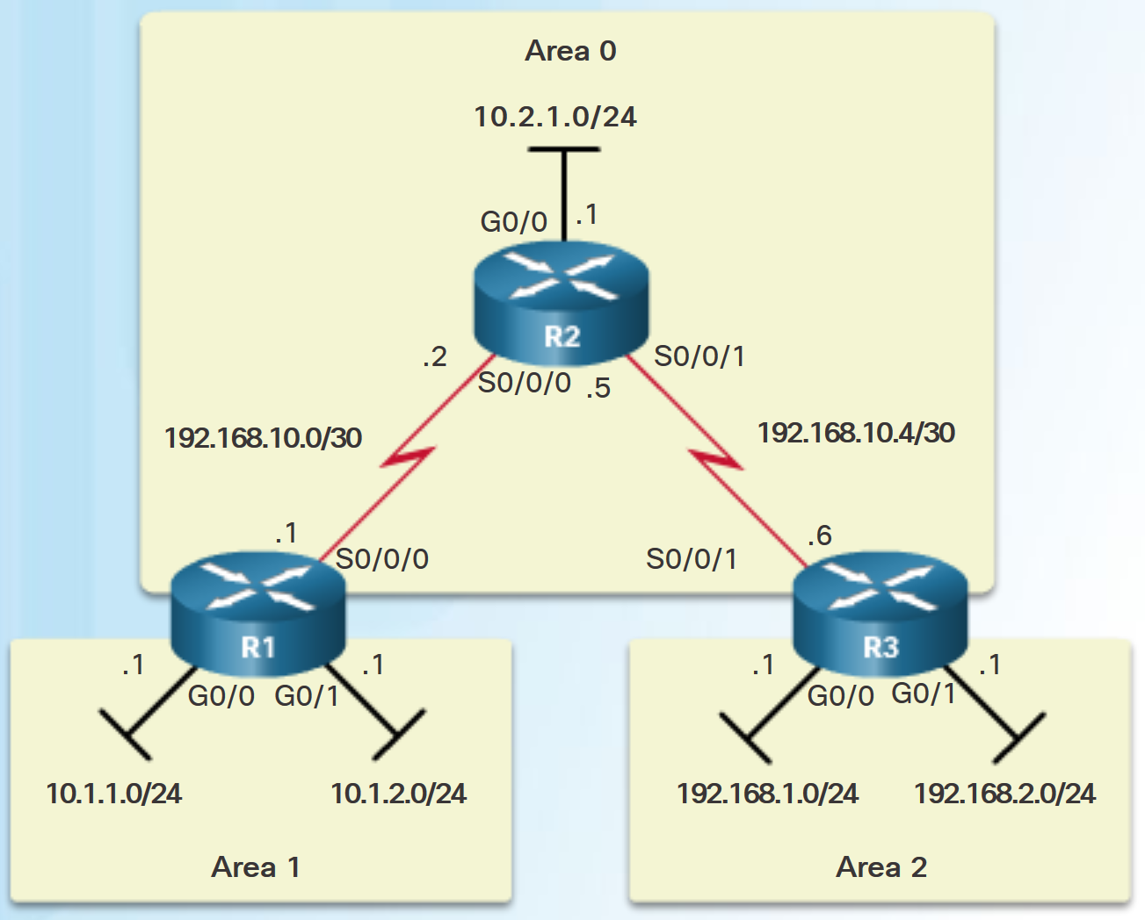
Verifying Multiarea OSPF Verifying Multiarea OSPFv2
Commands to verify multiarea OSPFv2
show ip ospf neighbor
show ip ospf
show ip ospf interface
Show ip protocols
show ip ospf interface brief
show ip route ospf
show ip ospf database
Note: For the equivalent OSPFv3 command, simply substitute ipv6 for ip.
Notes:
9.2 – Configuring Multiarea OSPF
9.2.2 – Verifying Multiarea OSPF
9.2.2.1 – Verifying Multiarea OSPFv2

Slide 22
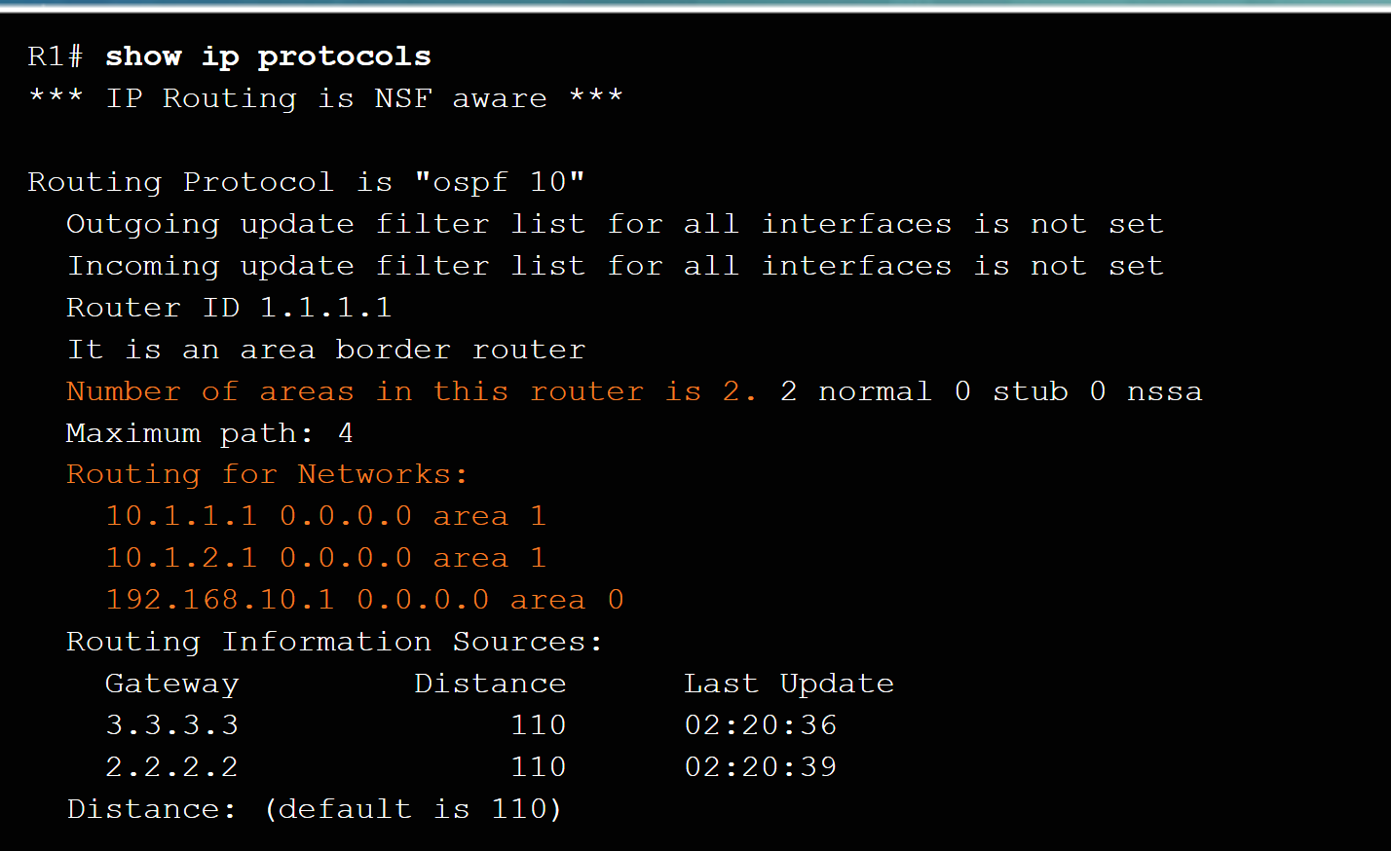
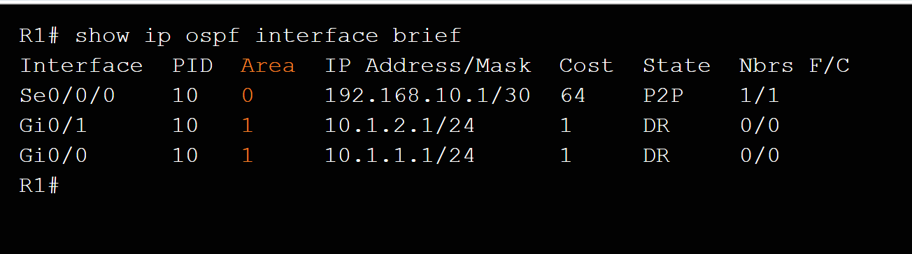
Verifying Multiarea OSPF Verify General Multiarea OSPFv2 Settings
Use the show ip protocols command to verify the OSPFv2 status.
Lists routing protocols configured on router, number of areas, router ID and networks included in routing protocol.
Use the show ip ospf interface brief command to display OSPFv2-related information for OSPFv2-enabled interfaces.
Lists the OSPFv2 process ID, area that the interfaces are in, and interface cost.
Notes:
9.2 – Configuring Multiarea OSPF
9.2.2 – Verifying Multiarea OSPF
9.2.2.2 – Verify General Multiarea OSPFv2 Settings

Slide 23
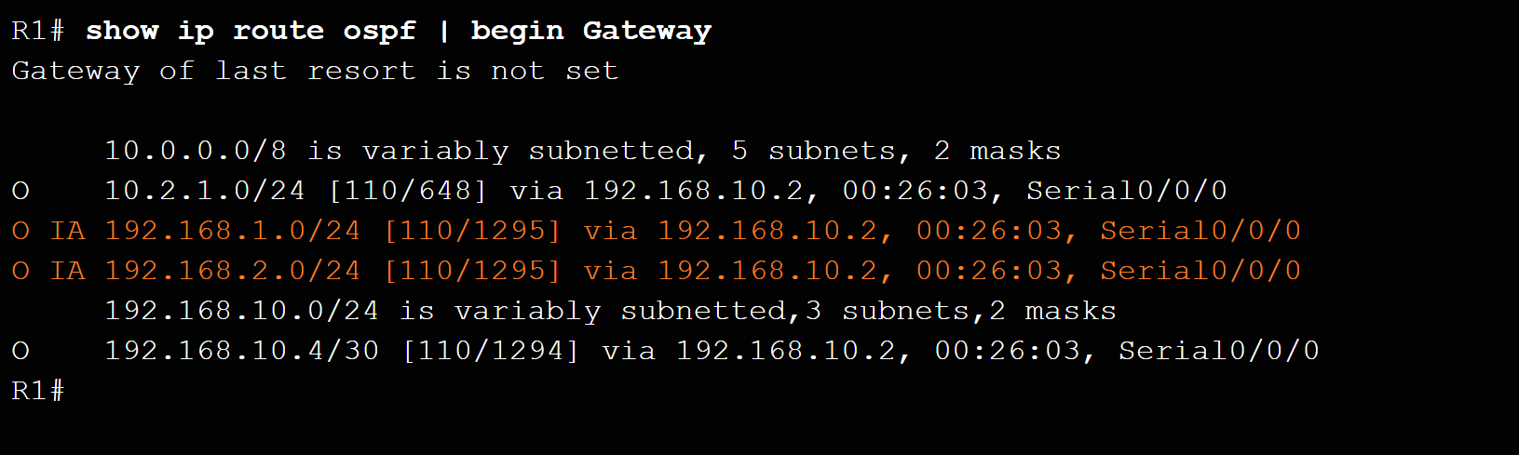
Verifying Multiarea OSPF Verify the OSPFv2 Routes
Use the show ip route ospf command to verify the muliarea OSPFv2 configuration..
O represents OSPFv2 routes and IA represents interarea, which means that the route originated from another area.
Notes:
9.2 – Configuring Multiarea OSPF
9.2.2 – Verifying Multiarea OSPF
9.2.2.3 – Verify the OSPFv2 Routes

Slide 24
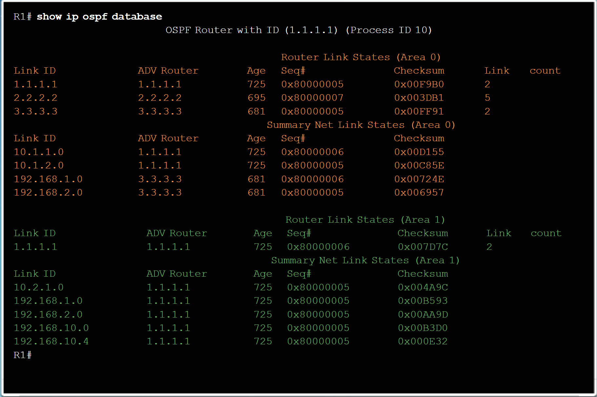
Verifying Multiarea OSPF Verify the Multiarea OSPFv2 LSDB
Use the show ip ospf database command to verify the contents of the OSPFv2 LSDB.
Notes:
9.2 – Configuring Multiarea OSPF
9.2.2 – Verifying Multiarea OSPF
9.2.2.4 – Verify the Multiarea OSPFv2 LSDB

Slide 25
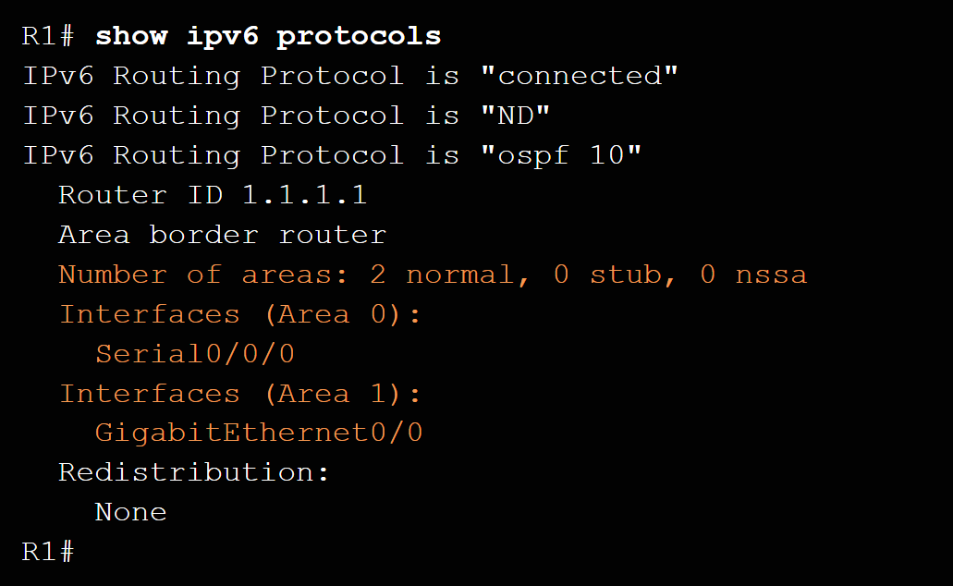
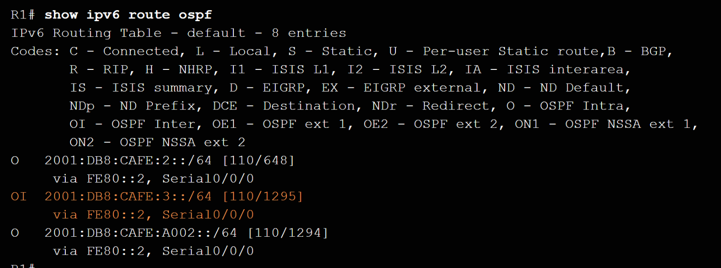
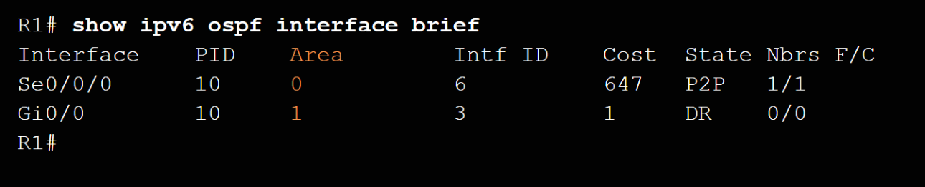
Verifying Multiarea OSPF Verify Multiarea OSPFv3
Use the show ipv6 protocols command to verifyOSPFv3.
Use the show ipv6 interface brief to verify the OSPFv3-enabled interfaces and the area to which they belong.
Use show ipv6 route ospf to display the routing table.
Use show ipv6 ospf database to display the contents of the LSDB.
Notes:
9.2 – Configuring Multiarea OSPF
9.2.2 – Verifying Multiarea OSPF
9.2.2.5 – Verify Multiarea OSPFv3

Slide 26
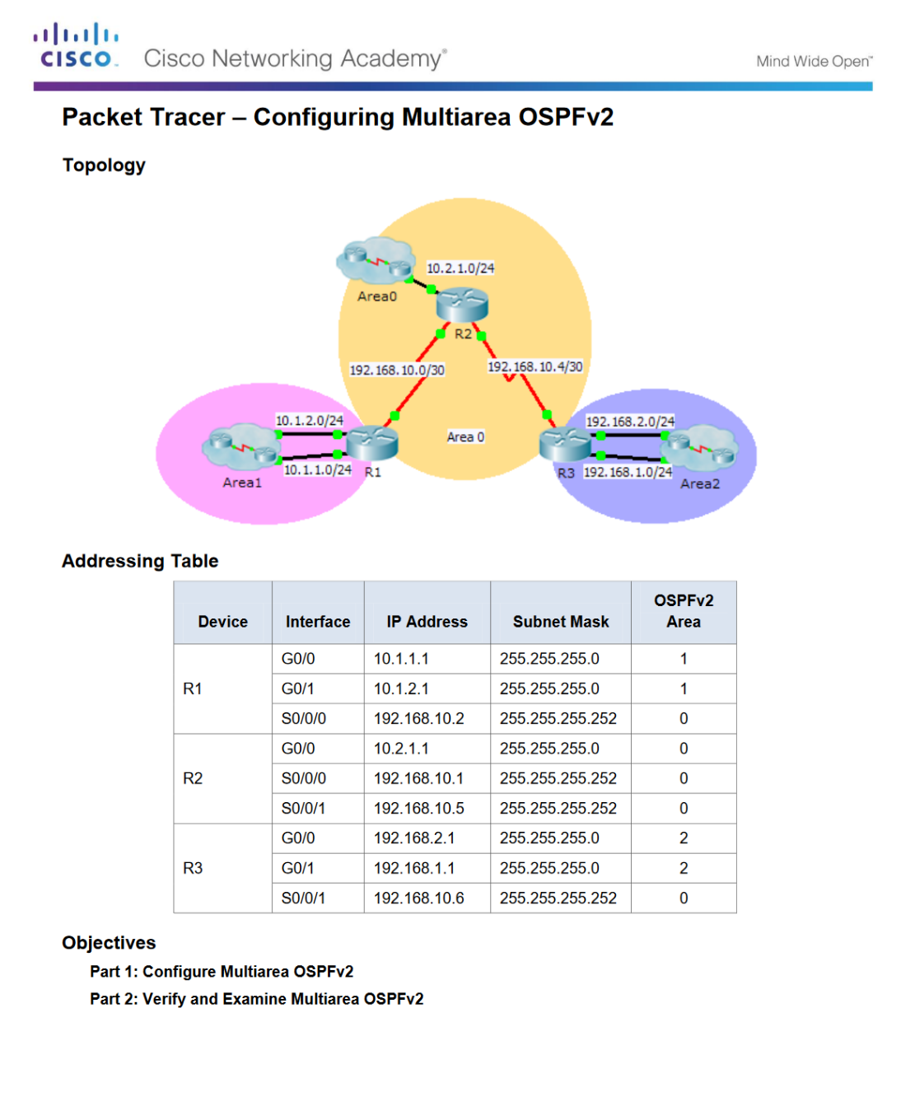
Verifying Multiarea OSPF Packet Tracer - Configuring Multiarea OSPFv2
Notes:
9.2 – Configuring Multiarea OSPF
9.2.2 – Verifying Multiarea OSPF
9.2.2.6 – Packet Tracer - Configuring Multiarea OSPFv2

Slide 27
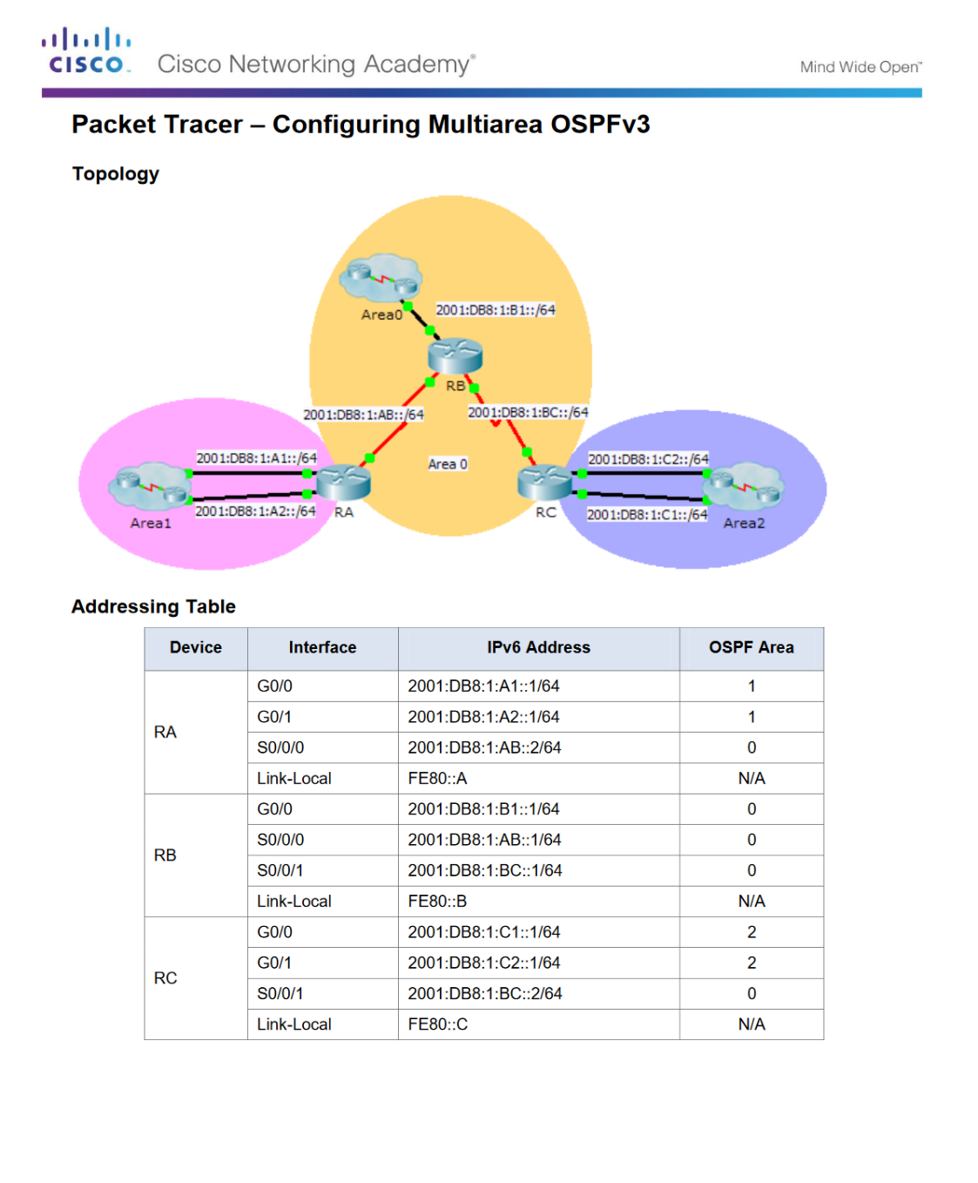
Verifying Multiarea OSPF Packet Tracer - Configuring Multiarea OSPFv3
Notes:
9.2 – Configuring Multiarea OSPF
9.2.2 – Verifying Multiarea OSPF
9.2.2.7 – Packet Tracer - Configuring Multiarea OSPFv3

Slide 28
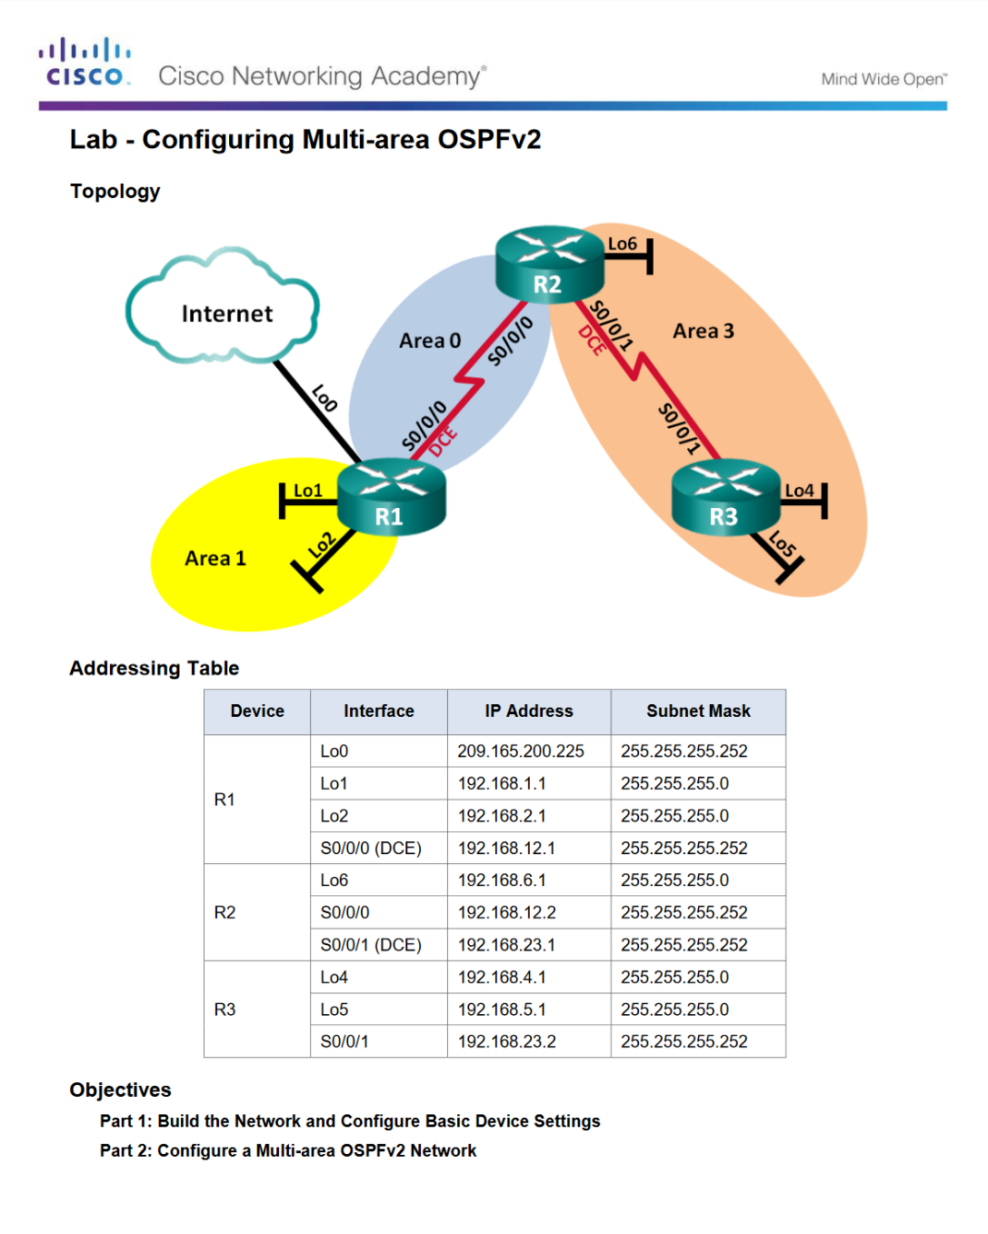
Verifying Multiarea OSPF Lab - Configuring Multiarea OSPFv2
Notes:
9.2 – Configuring Multiarea OSPF
9.2.2 – Verifying Multiarea OSPF
9.2.2.8 – Lab - Configuring Multi-area OSPFv2

Slide 29
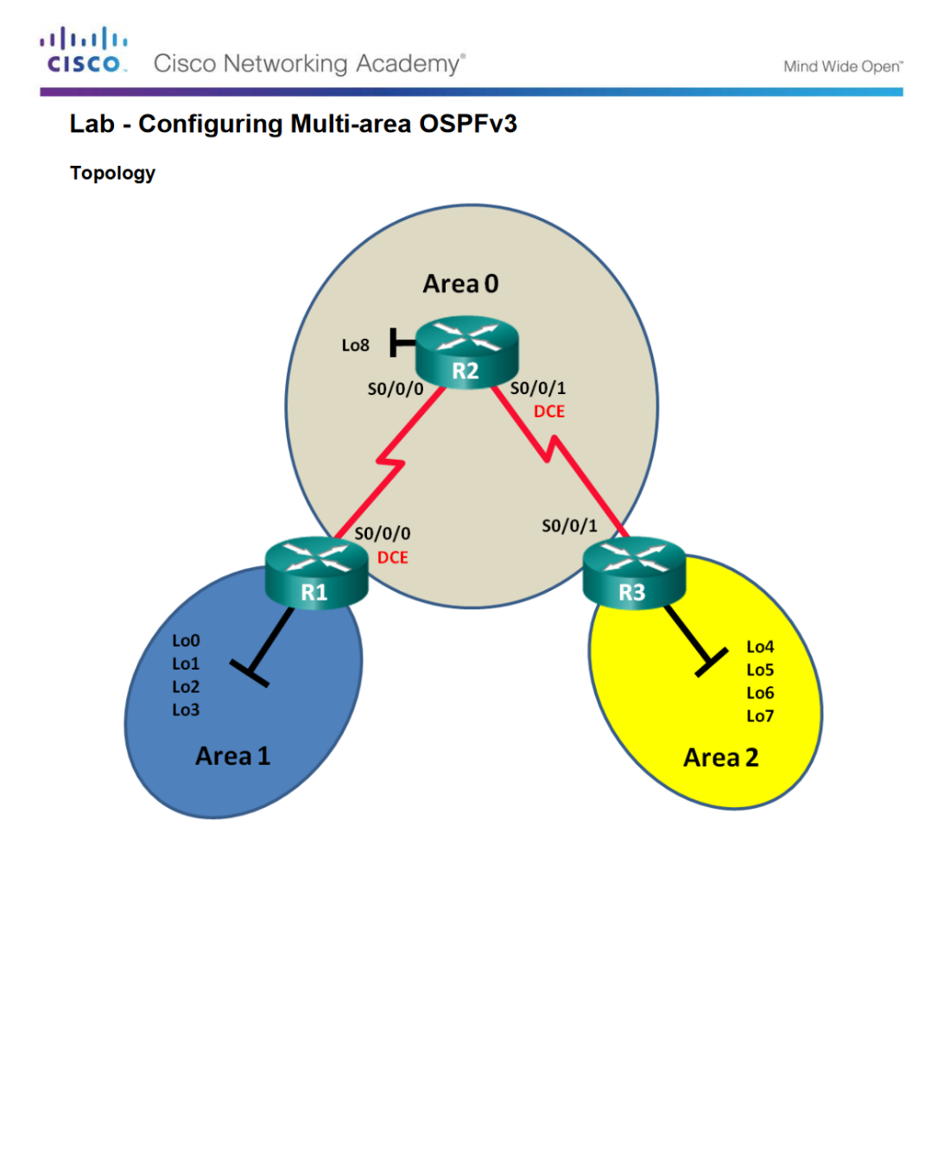
Verifying Multiarea OSPF Lab - Configuring Multiarea OSPFv3
Notes:
9.2 – Configuring Multiarea OSPF
9.2.2 – Verifying Multiarea OSPF
9.2.2.9 – Lab - Configuring Multi-area OSPFv3

Slide 30
9.3 Chapter Summary
Notes:
9 – Multiarea OSPF
9.3 – Summary

Slide 31
Conclusion Chapter 9: Multiarea OSPF
Explain how multiarea OSPF operates in a small to medium-sized business network.
Implement multiarea OSPFv2 and OSPFv3.
Notes:
9.3 – Summary
9.3.1 – Conclusion
9.3.1.2 – Chapter 9: Multiarea OSPF

Slide 32
Chapter 5: Dynamic Routing New Terms and Commands
Internal router Backbone router Autonomous System Boundary Router (ASBR) route redistribution LSA Type 1 LSA Type 2 LSA Type 3 LSA Type 4 LSA Type 5
Notes:
New Terms and Commands

